Slide 1
Learning Management System
CS3321 - FA2019

Slide 2
Our team and approach
Our GitHub
Team leader: Zachary Fradette
Team Model: Modern Programming Team
The team leader delegated work as the project advances through the workflows. During which, the programmers contributed to specific portions of the code.
Programmer: Anthony Pham
Programmer: Francisco Lopez
Programmer: David Lara
https://github.com/ZFoxtrot/UHDSoftwareEng
https://github.com/ZFoxtrot/UHDSoftwareEng

Slide 3
1A. Requirements Workflow >> Determining What The Client Needs
Domain: A school or university (used by both student and instructor)
Business Model: Facilitate management of school career
Understanding the domain and business model:
Unstructured interview of ourselves
As students who have experience with a learning management system (Blackboard Learn), we are able to better understand the client’s requirements.
What do students need to see?
What do students need to do?
What do staff need to see?
What do staff need to do?
Direct observation of ourselves
Going through similar functionality on Blackboard, we get a sense of what works and what doesn’t.

Slide 4
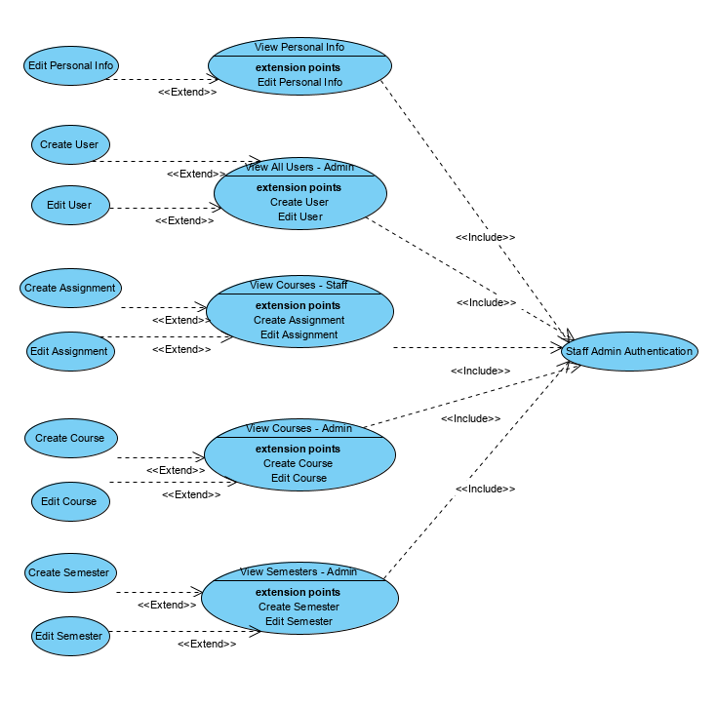
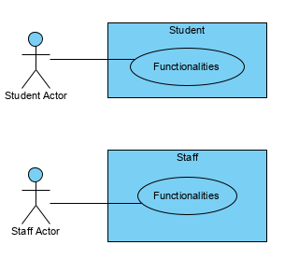
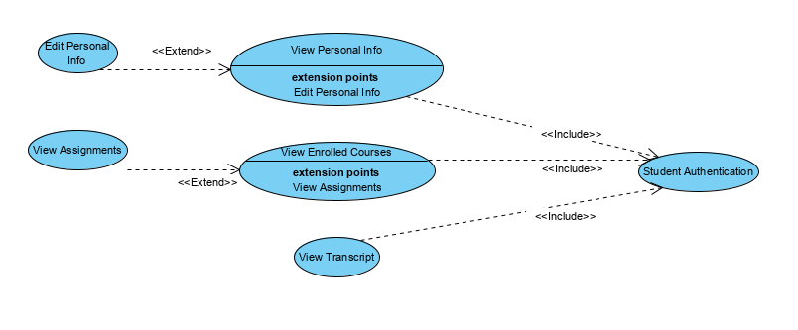
1B. Requirements >> Artifacts: Use Cases
Determining the users/actors
Student functionalities
Staff admin functionalities

Slide 5
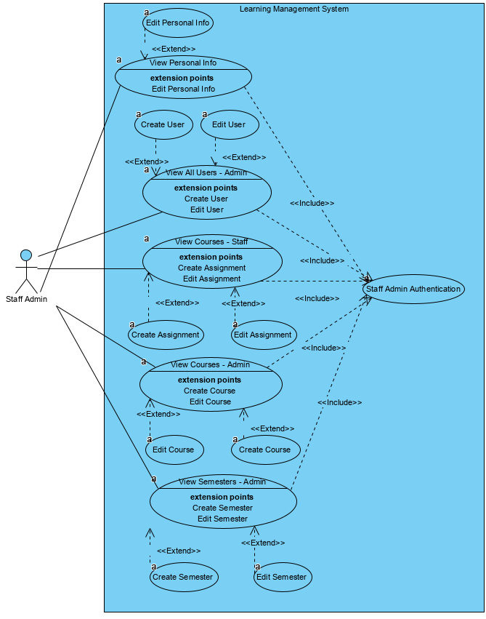
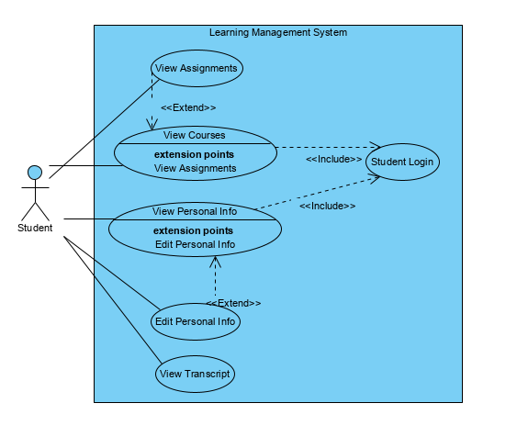
1C. Requirements >> Artifacts: Use Cases

Slide 6
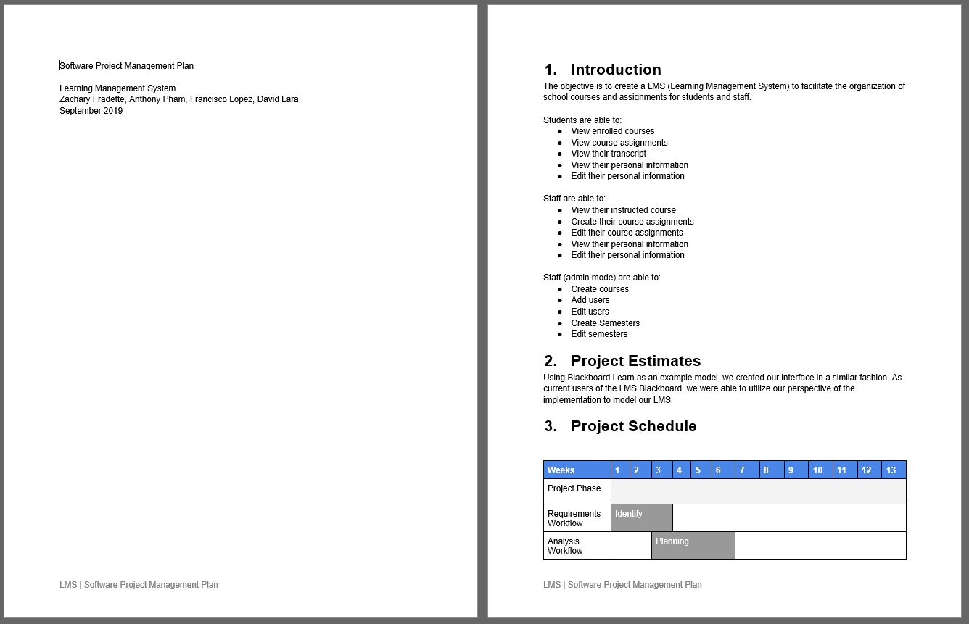
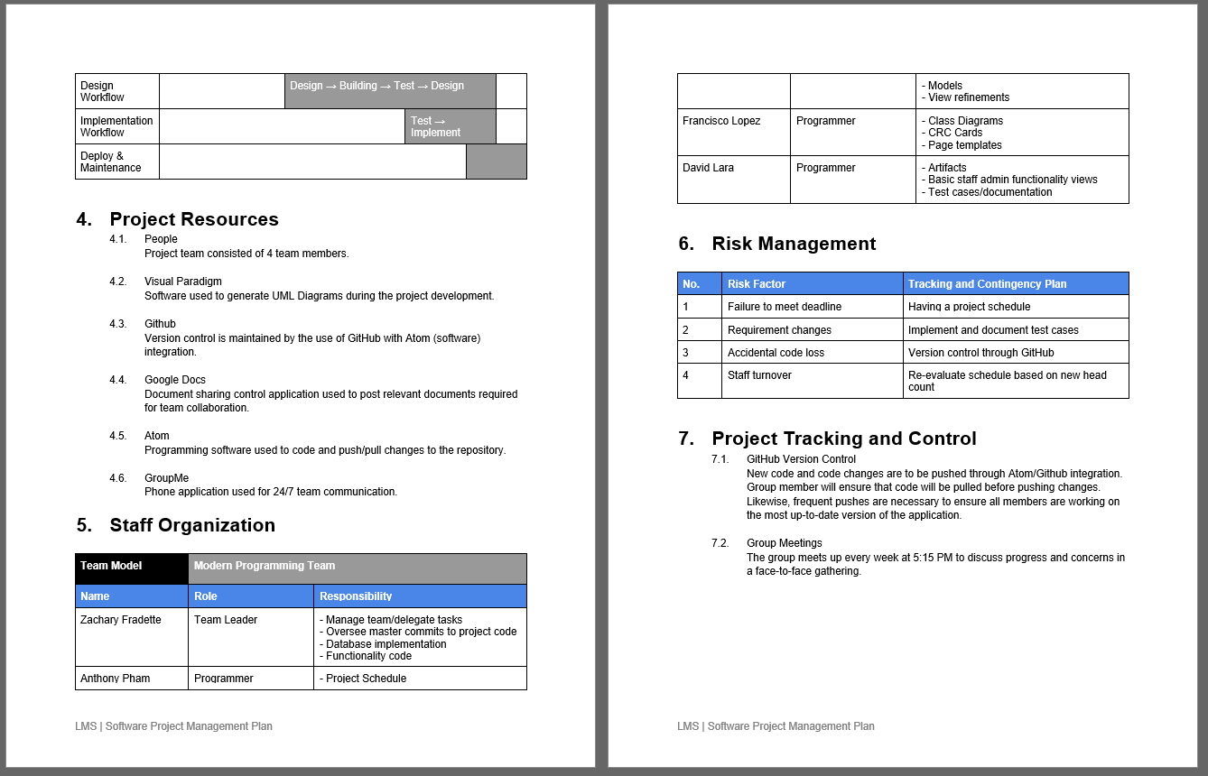
2A. Analysis Workflow >> A deeper understanding of the requirements

Slide 7
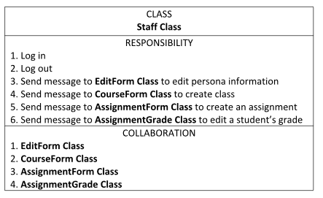
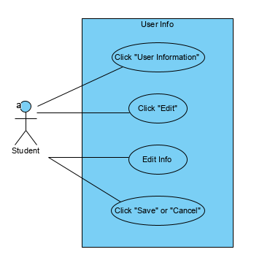
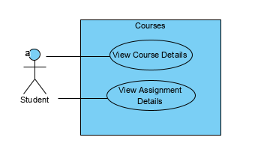
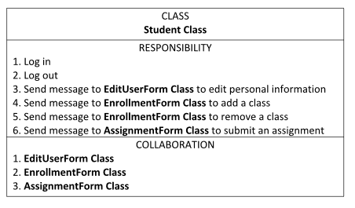
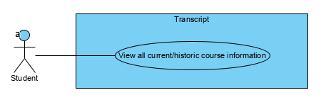
2B. Analysis >> Artifacts: Modeling

Slide 8
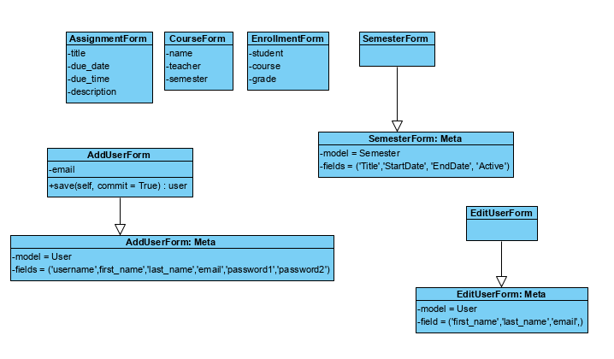
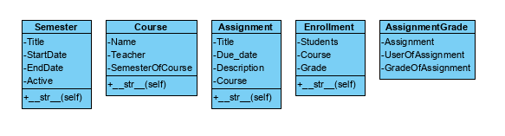
3A. Design Workflow
>> Refine artifacts from the analysis workflow
Classes to pull/push data from DB
Classes to pull/push data from DB

Slide 9
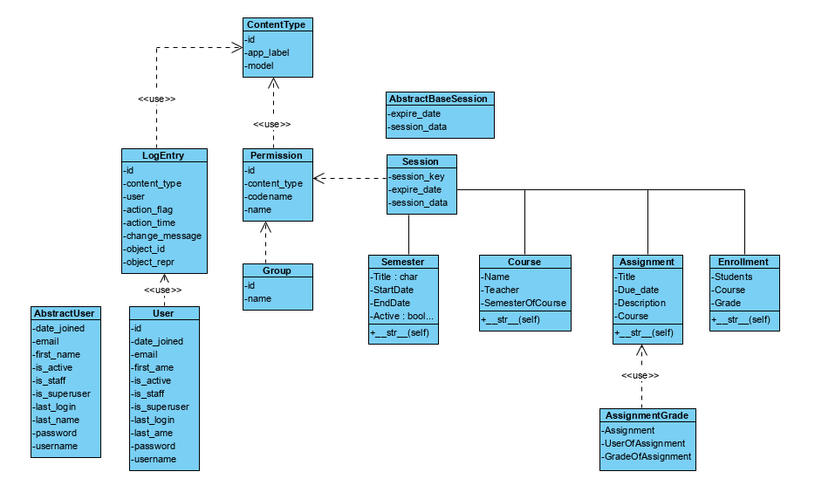
3B. Design
>> Artifacts: Class Diagrams

Slide 10
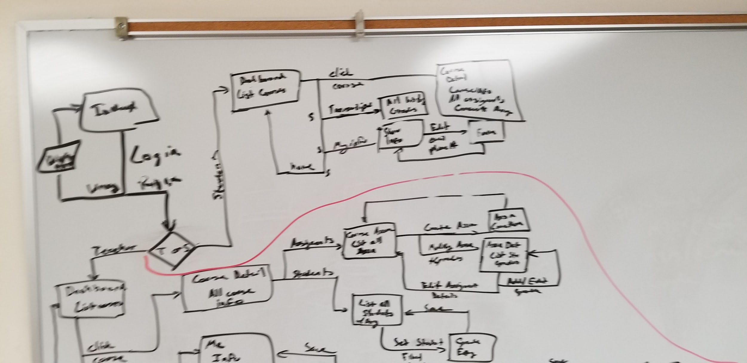
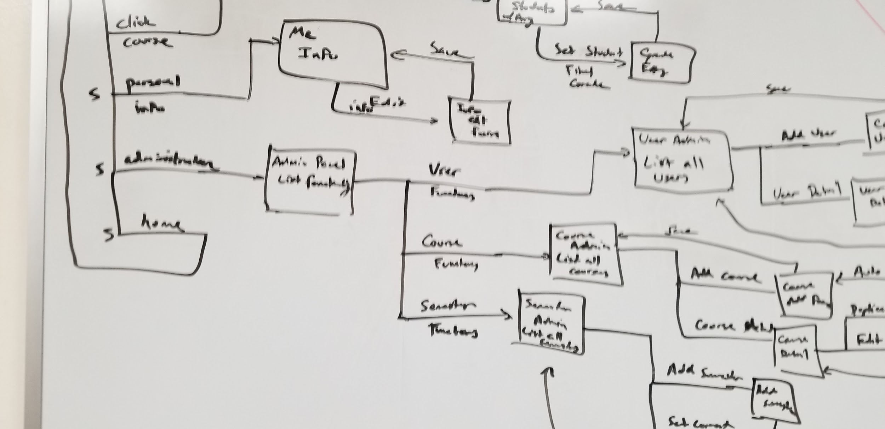
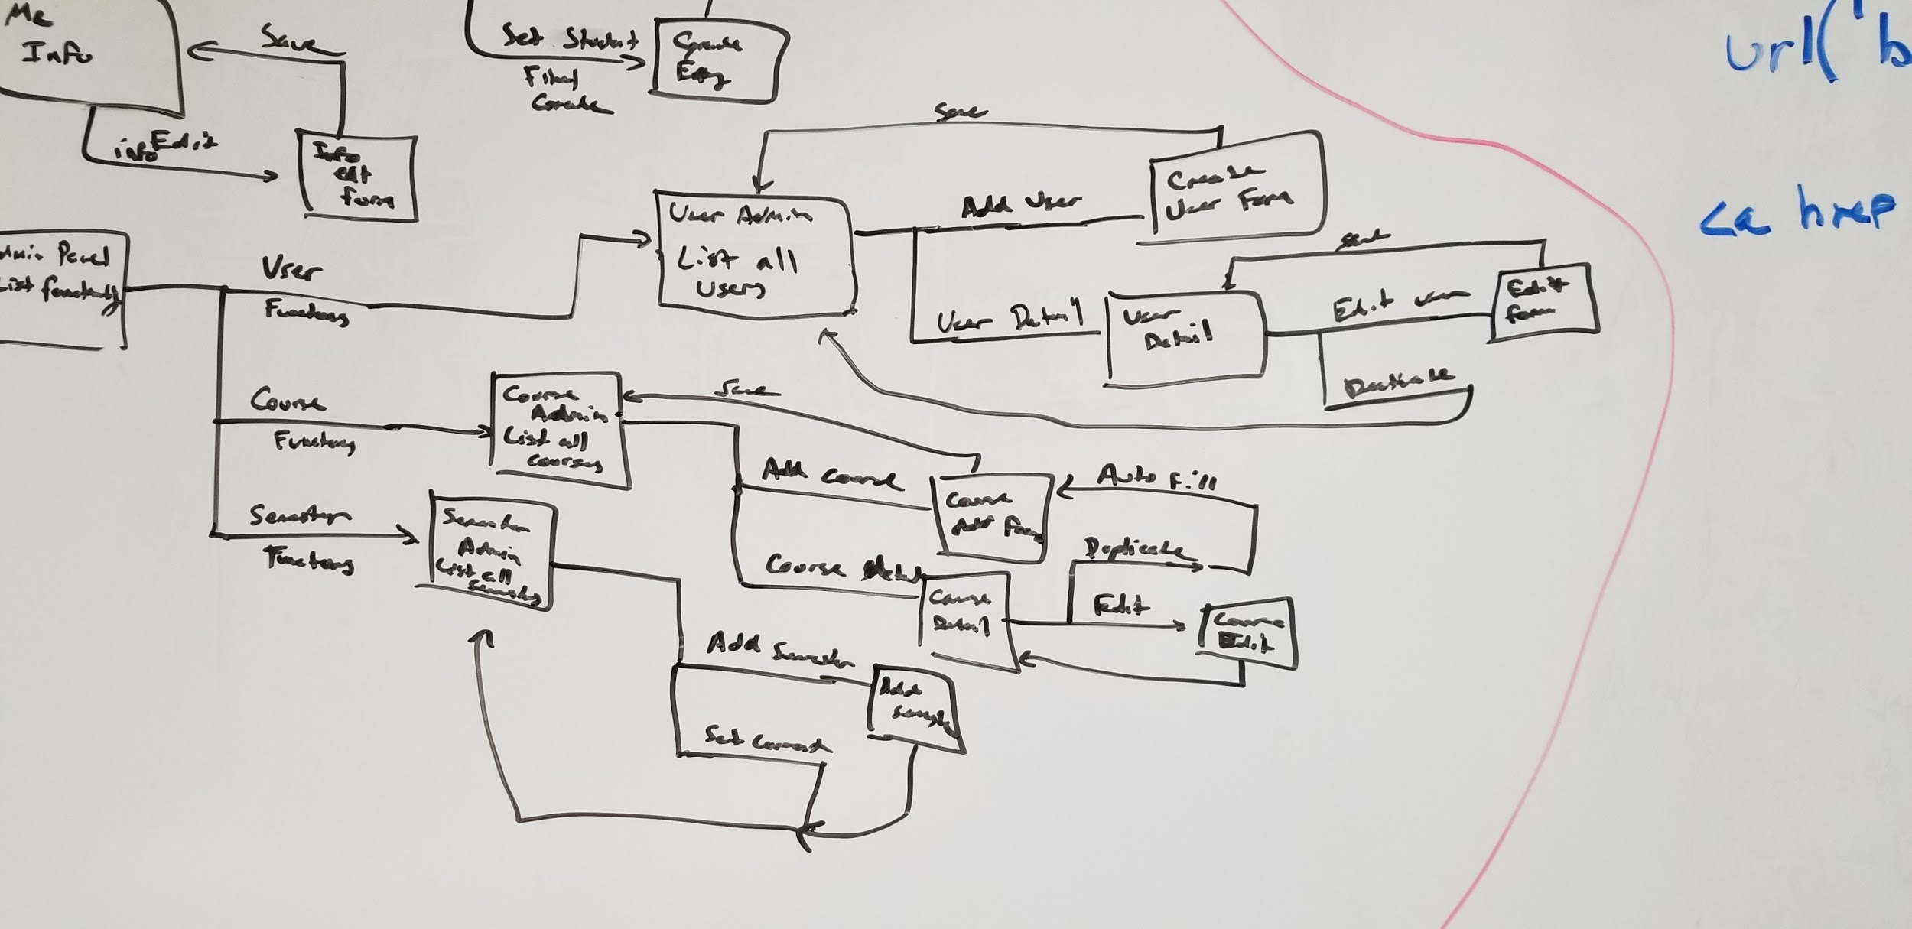
3C. Design >> Artifacts: Functionality Flow Drafts

Slide 11
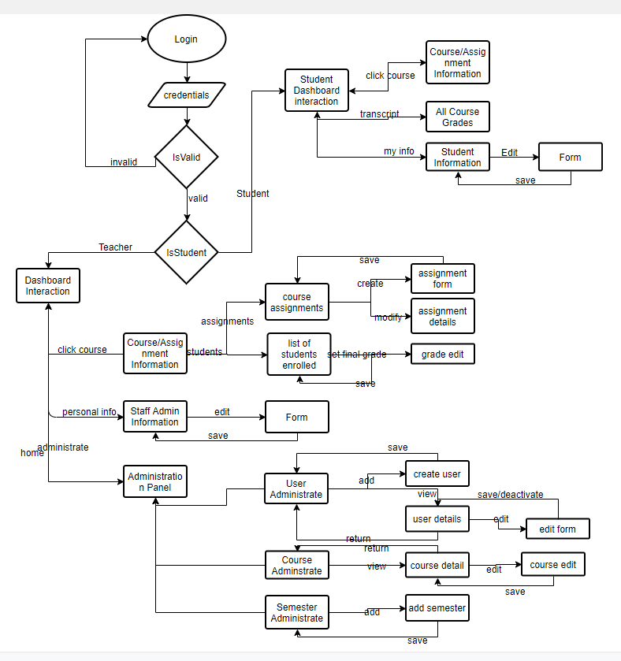
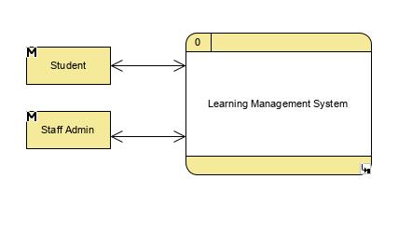
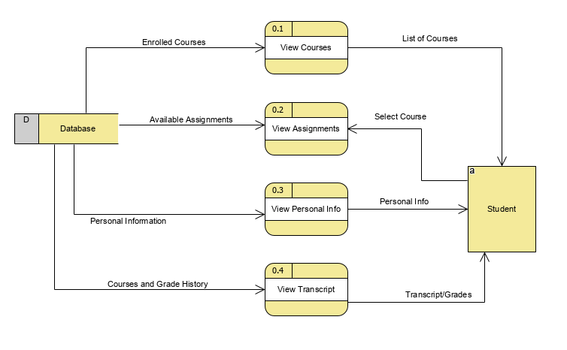
3D. Design >> Artifacts: Data Flow Diagrams

Slide 12
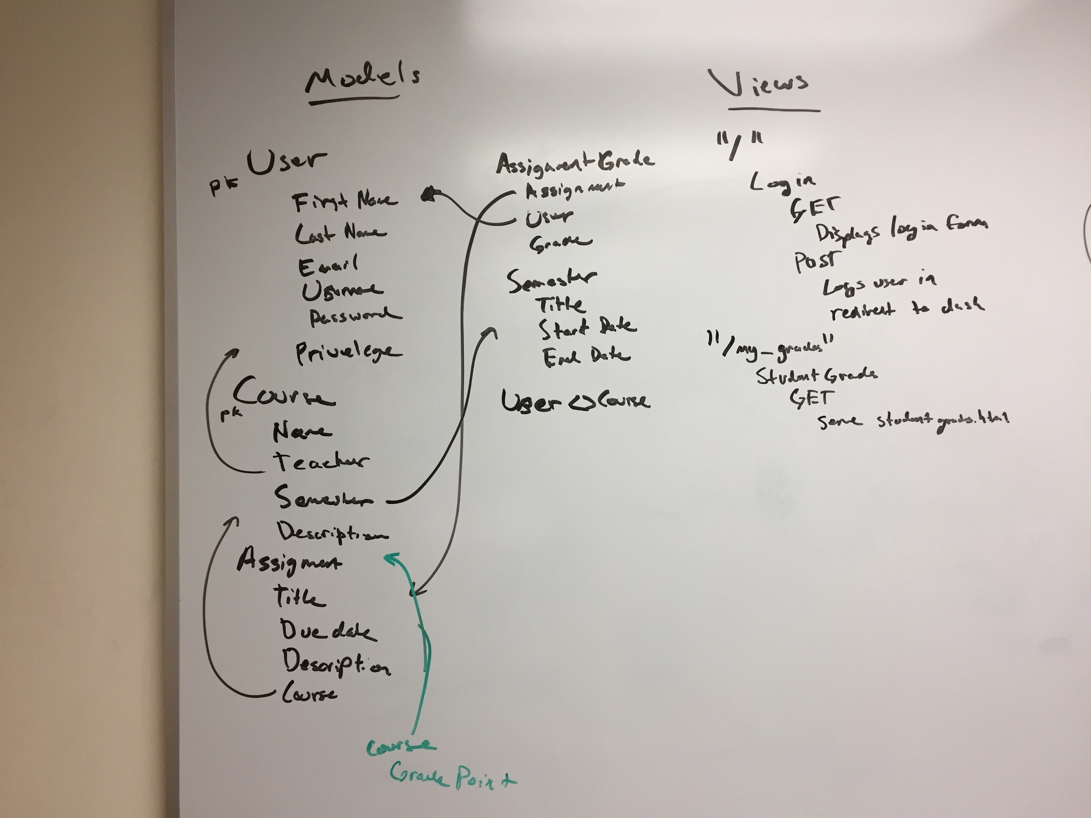
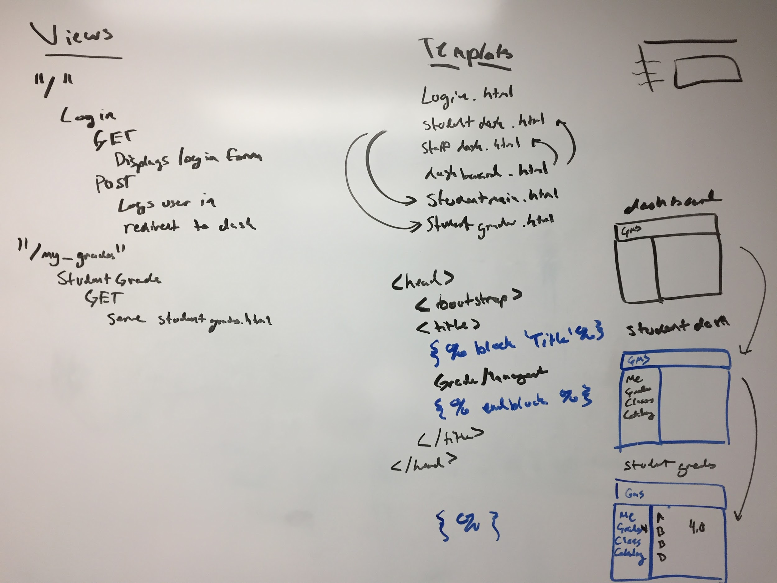
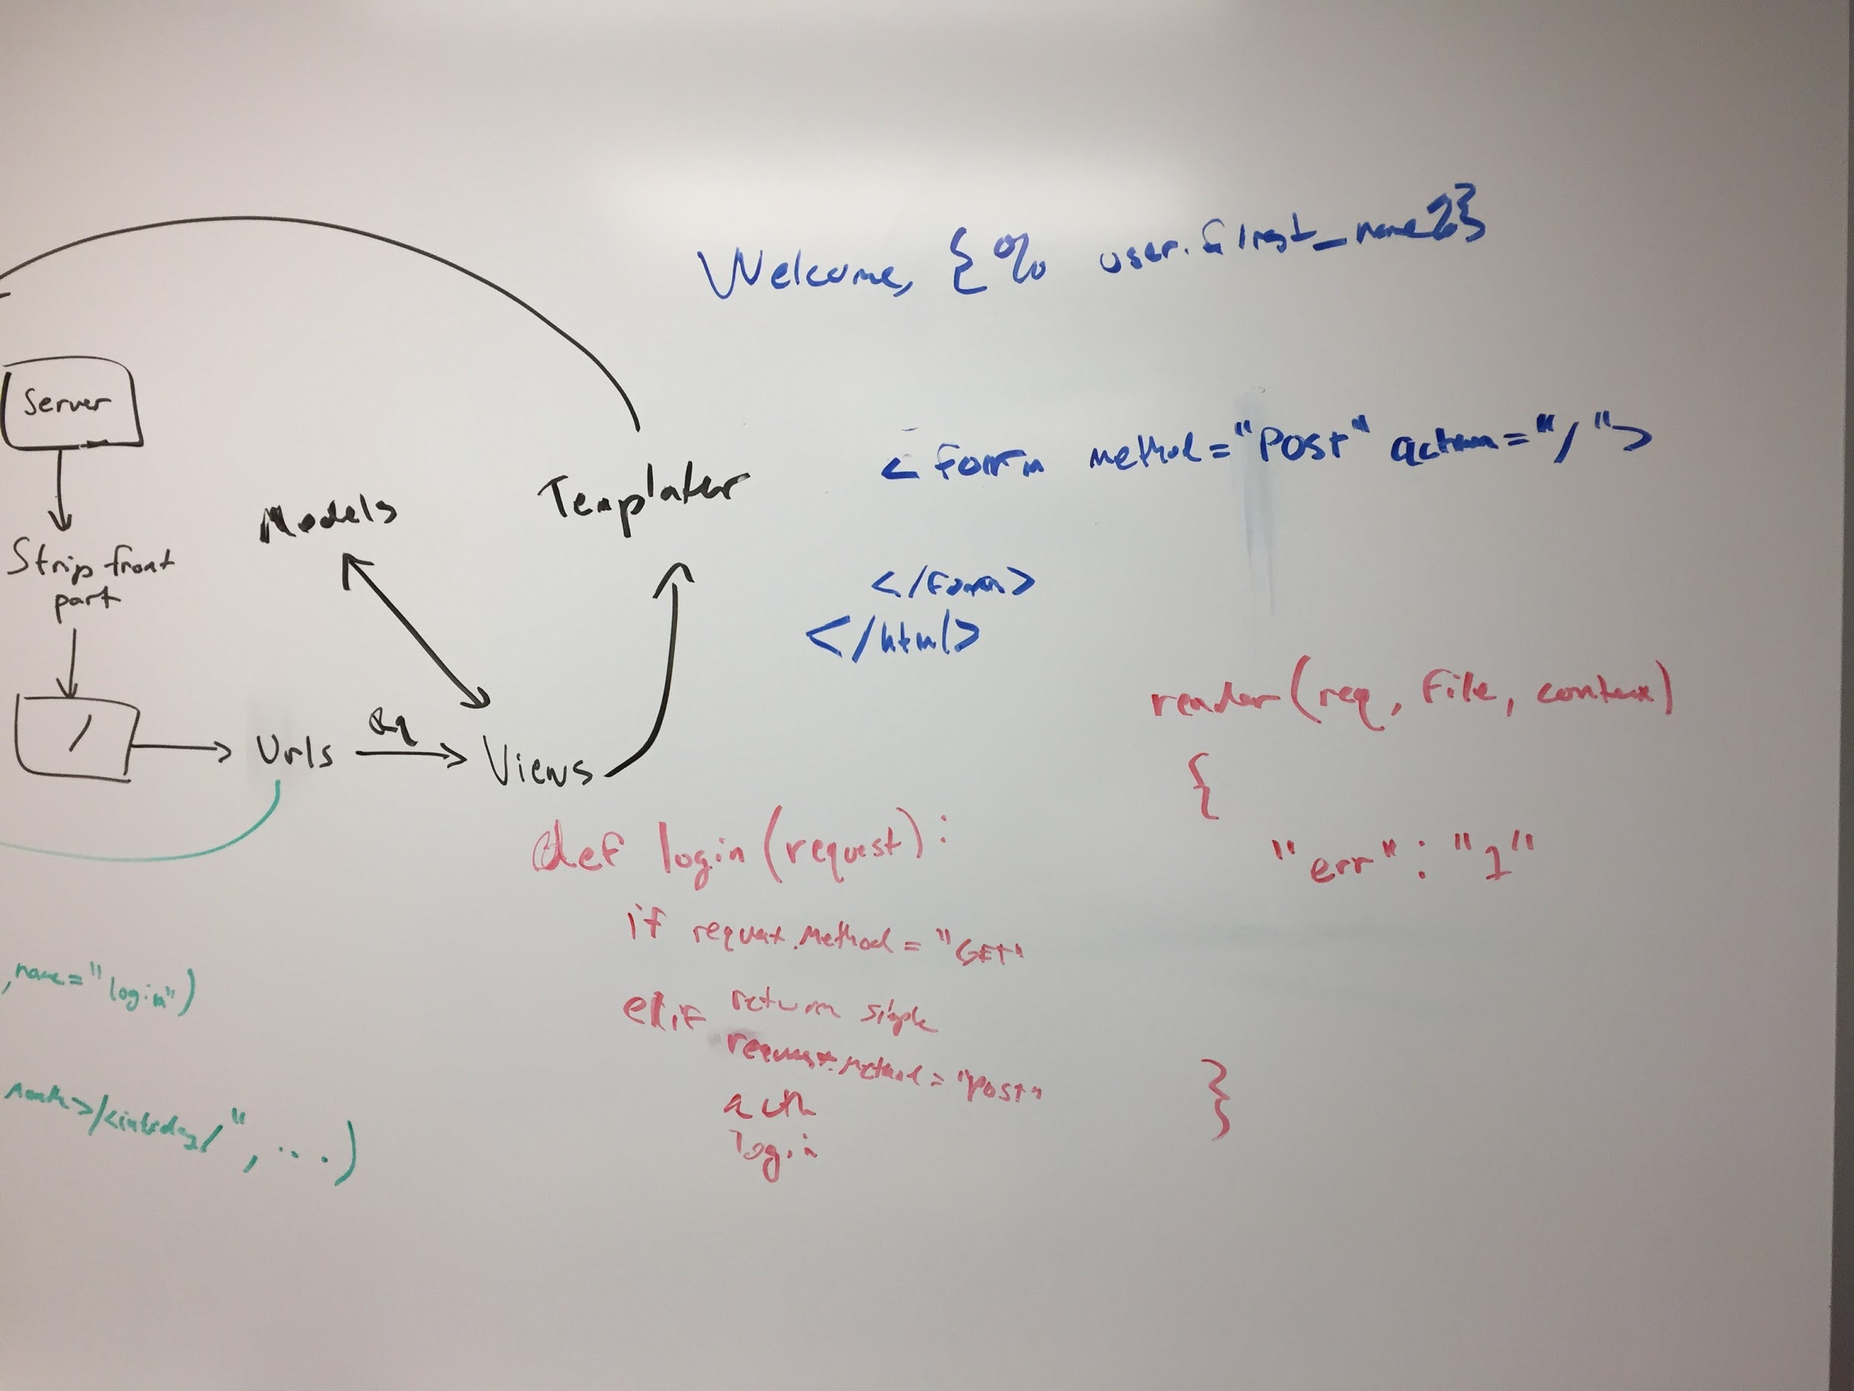
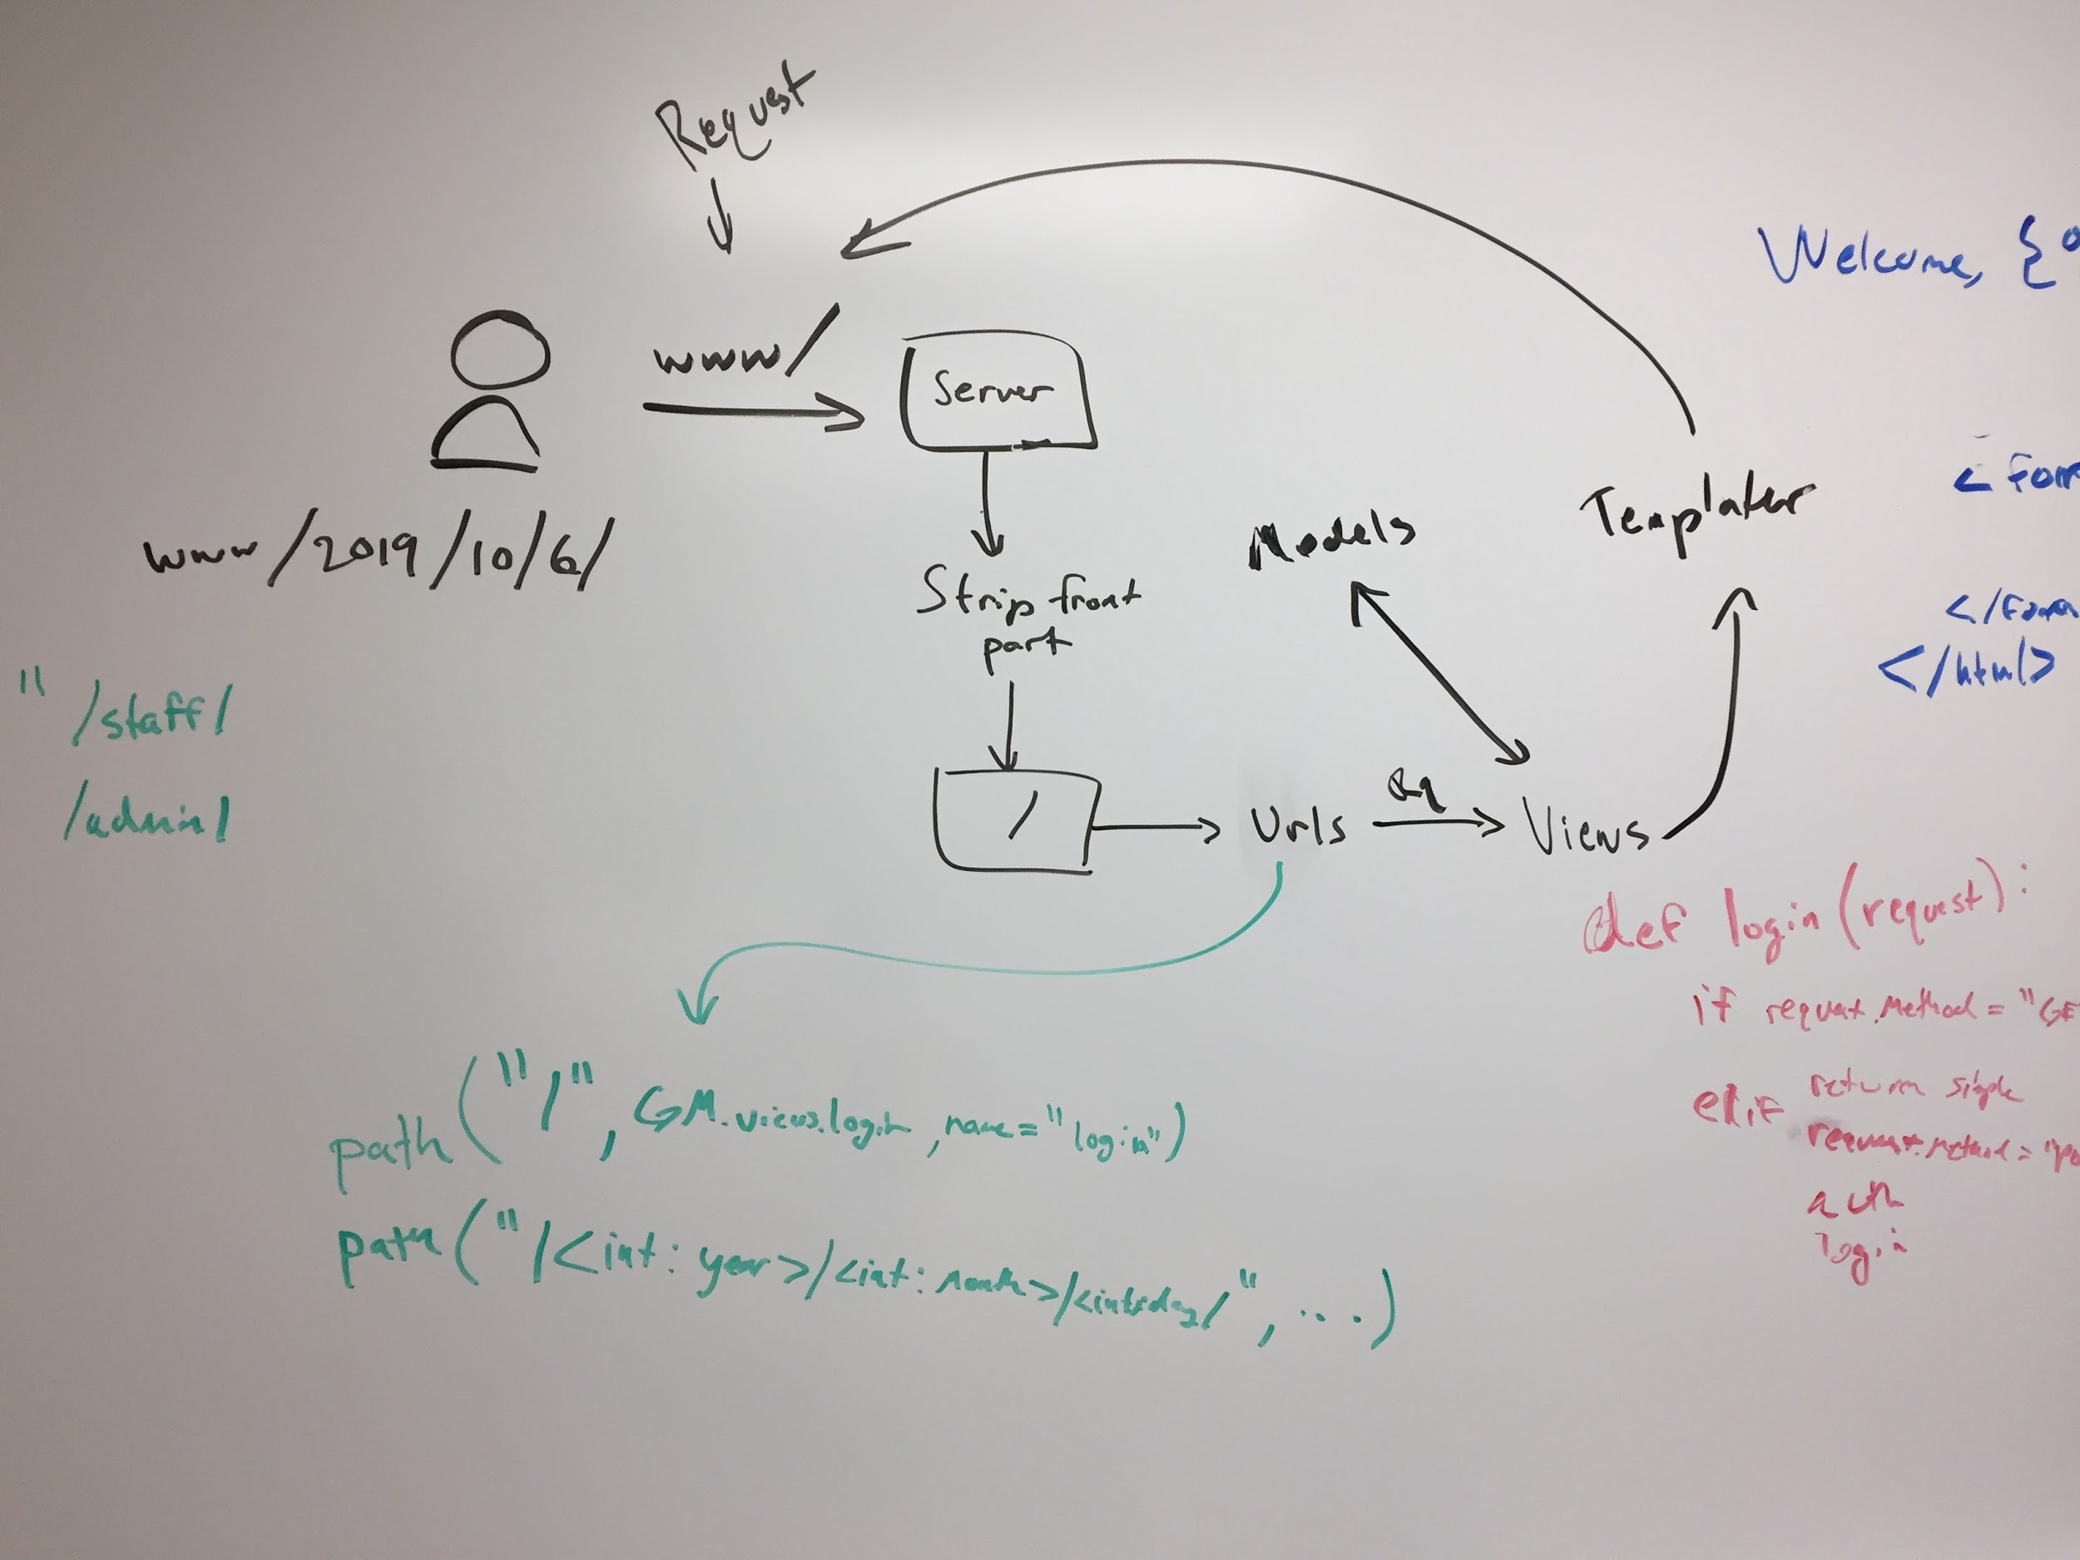



4A. Implementation Workflow >> Implement the target software to product

Slide 13
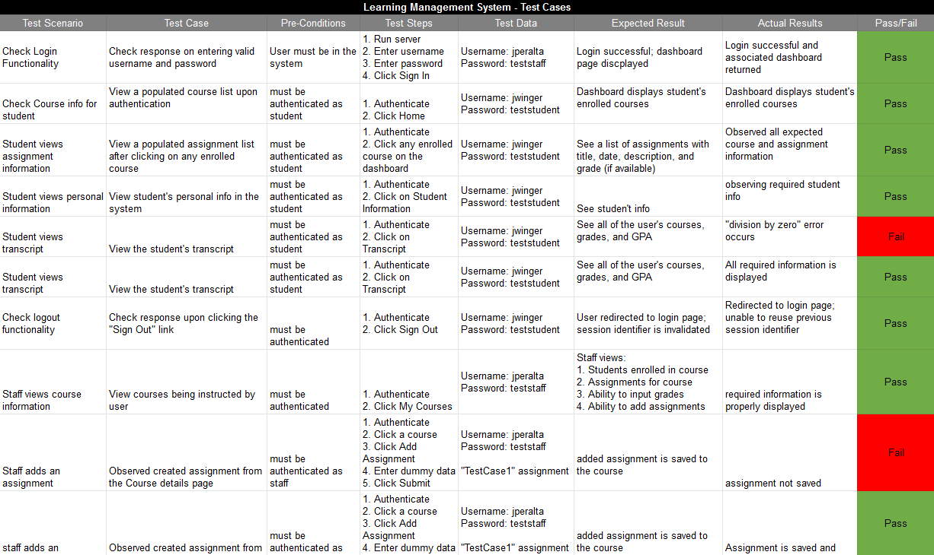
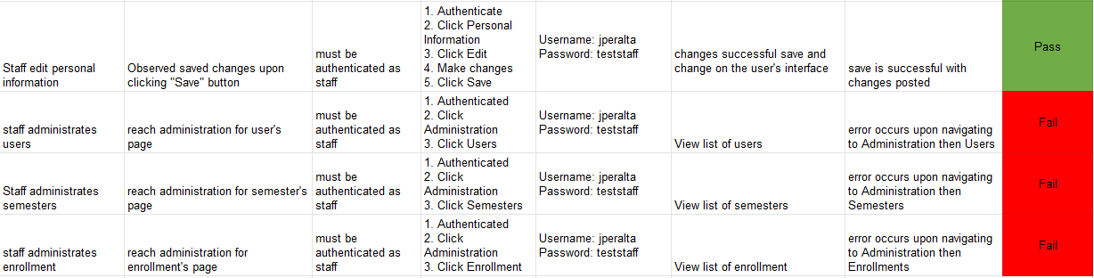
4B. Implementation >> Test Workflow: Implementation

Slide 14
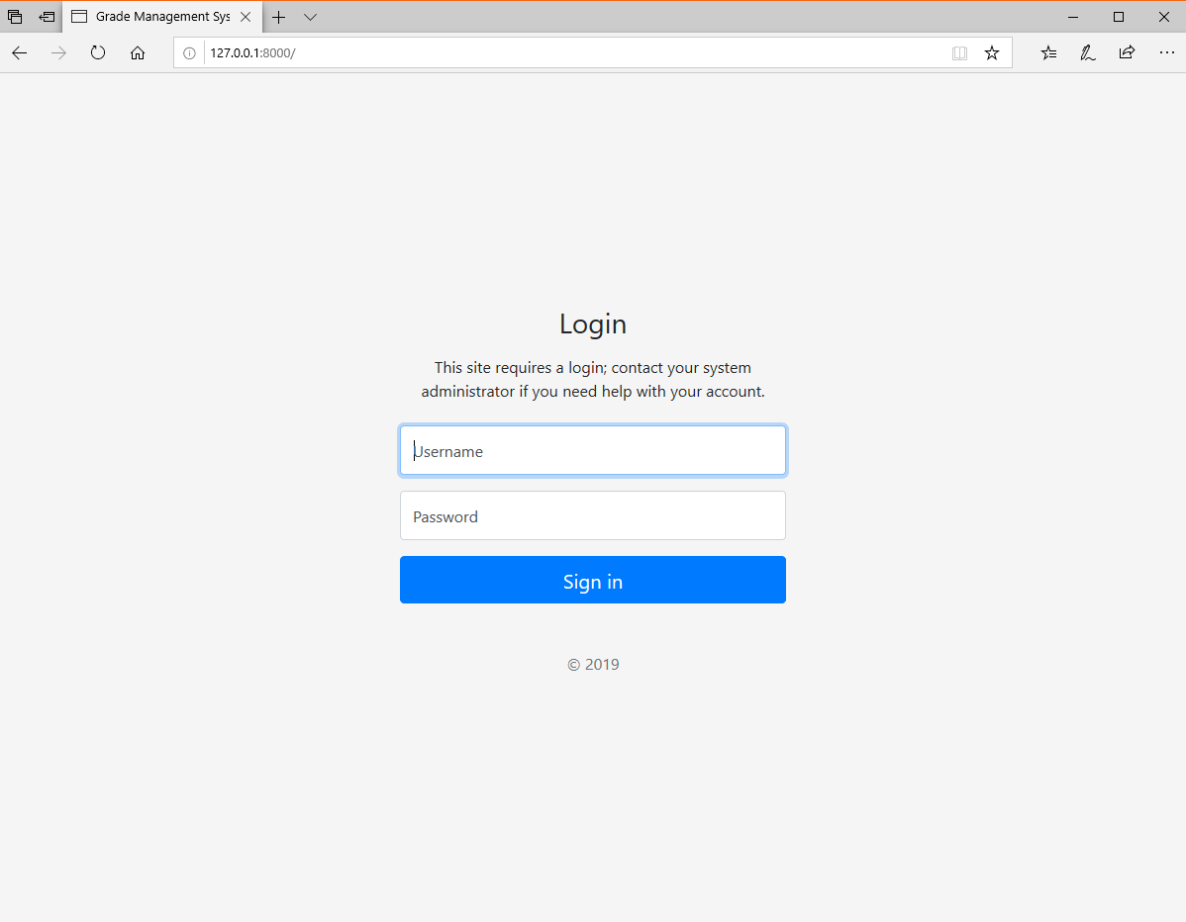
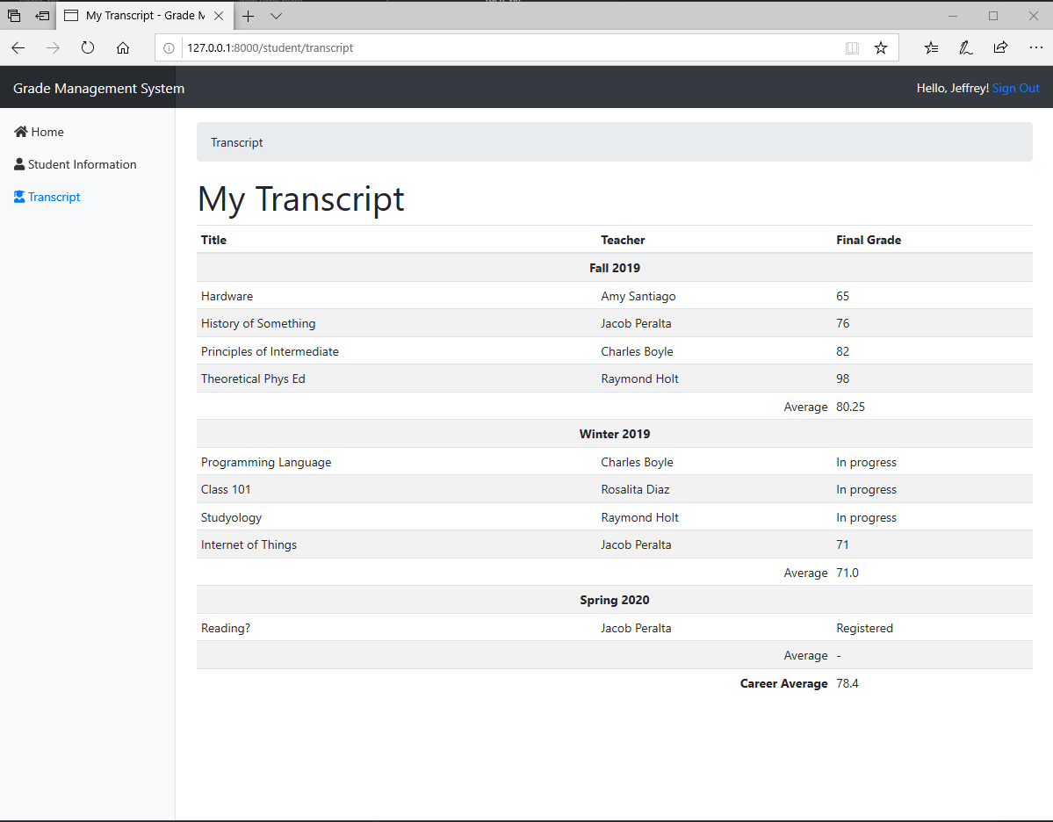
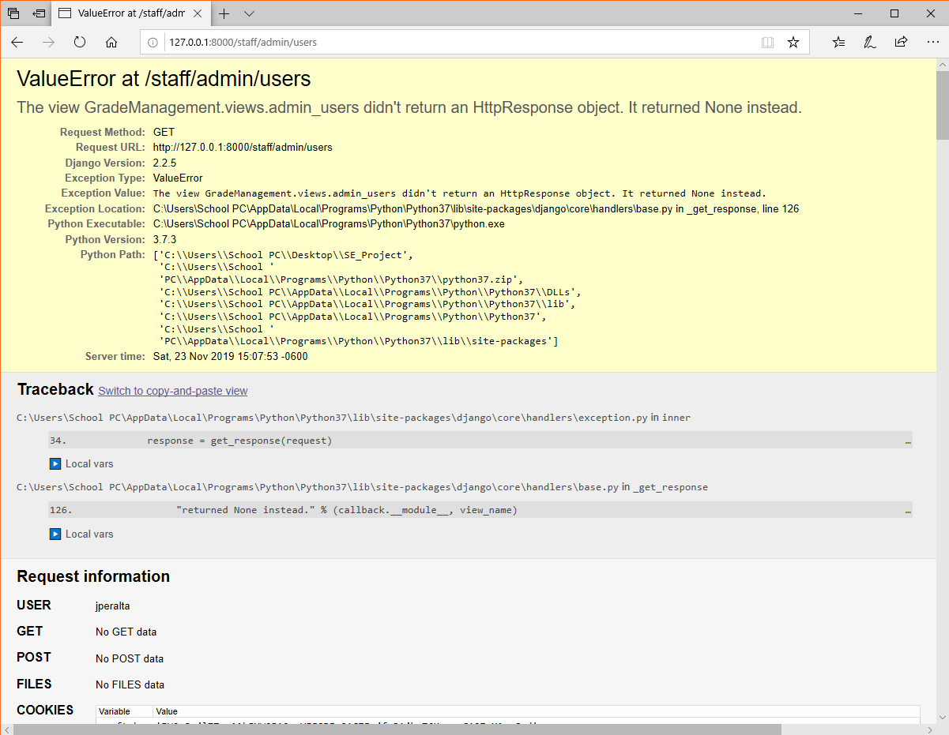
Demonstration

